Slide 1
The genome in 3D
An introduction to HiC
David Winter, Massey University

Slide 2
Assembling genomes in 2021

Slide 3
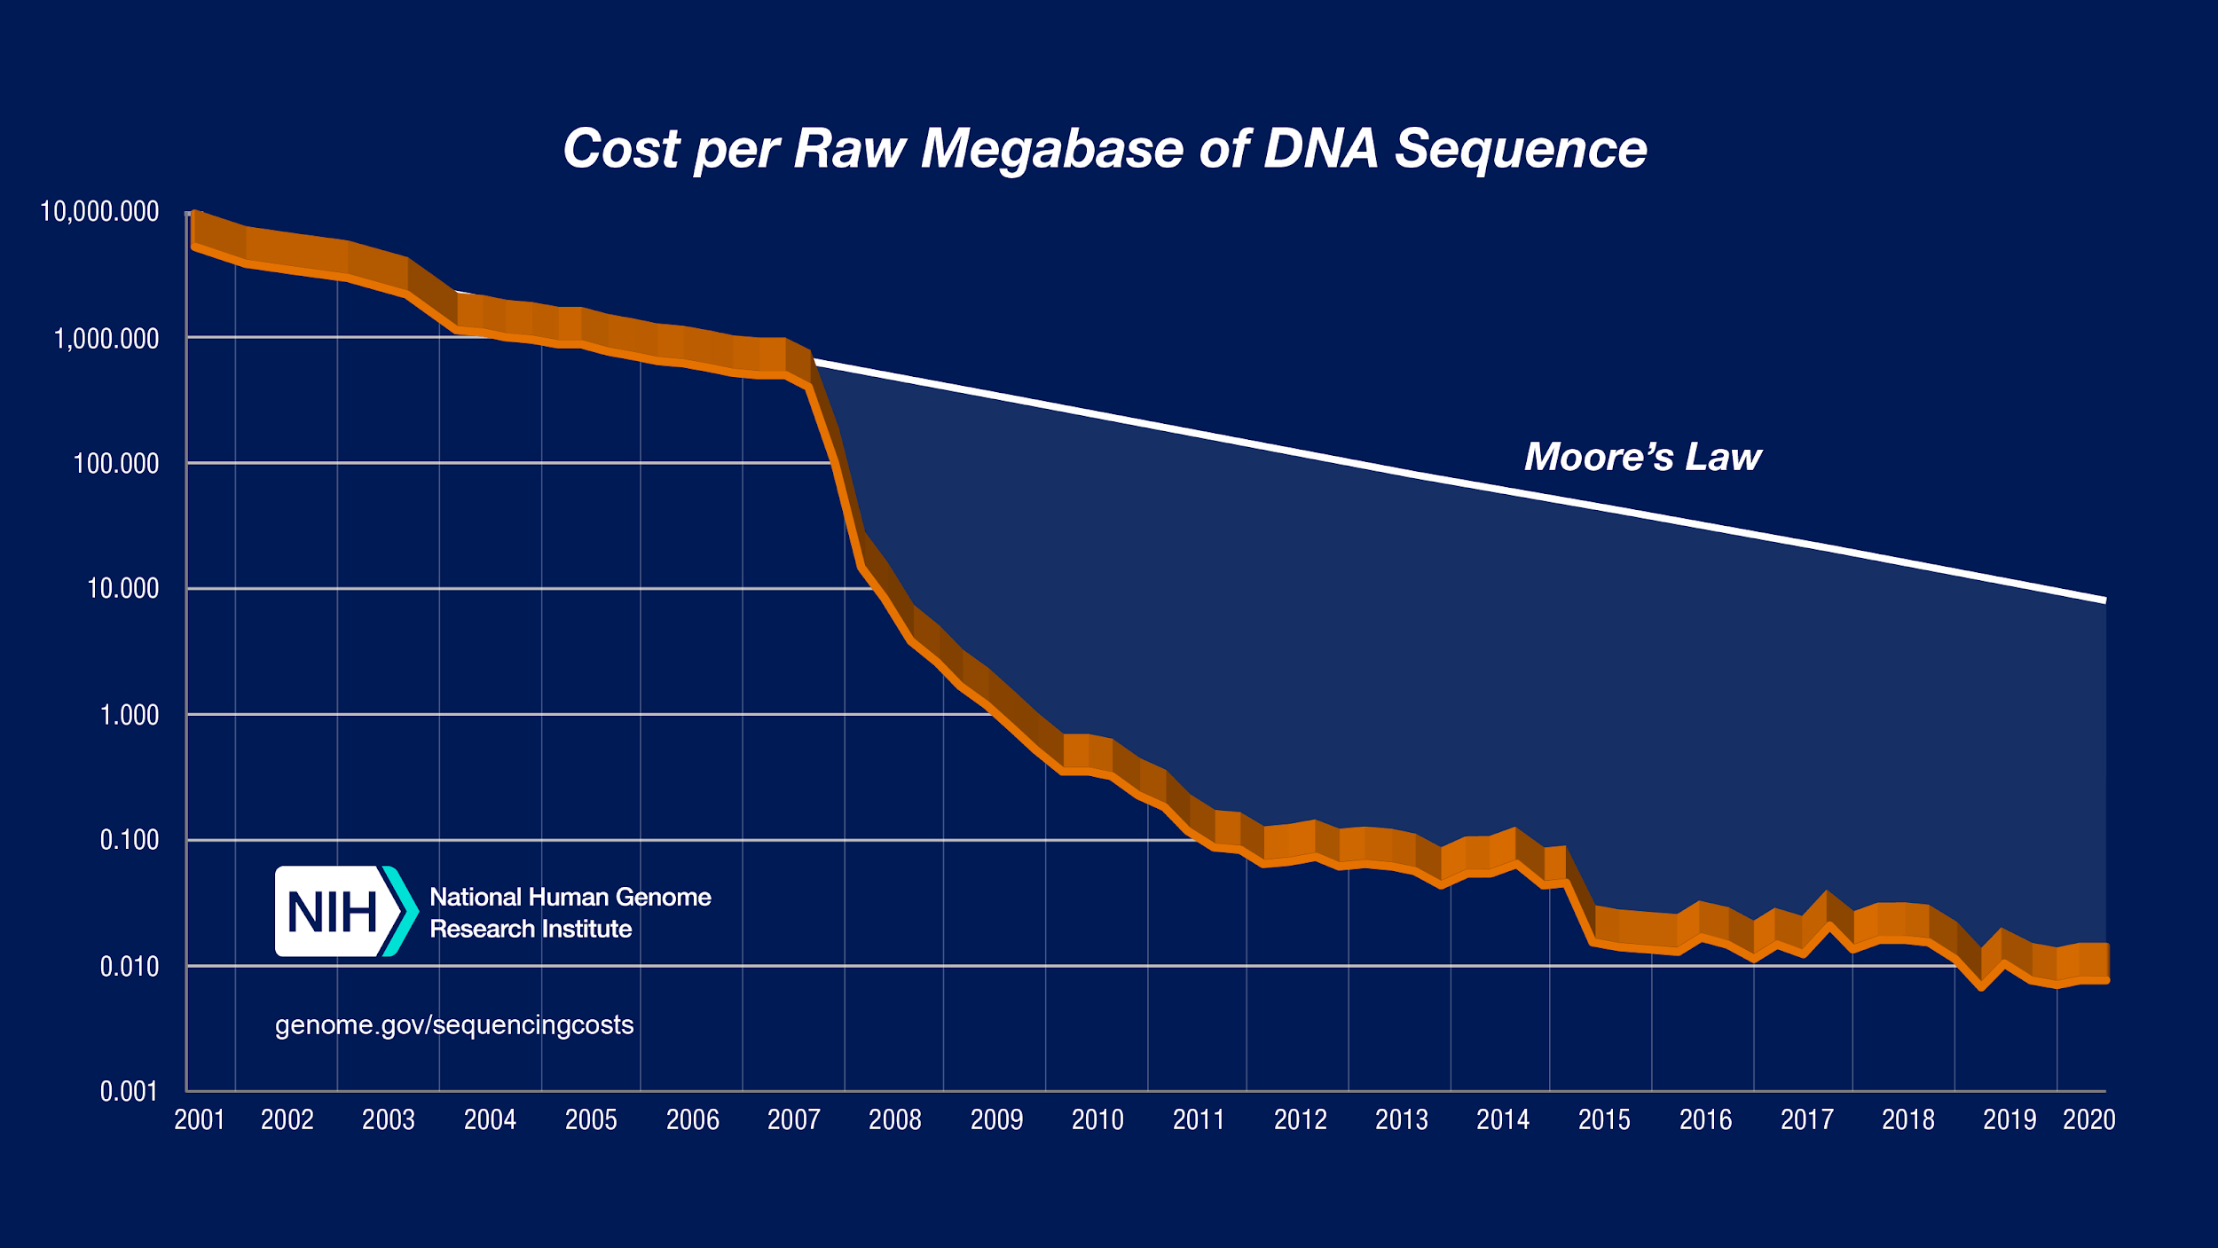
Assembling genomes in 2021

Slide 4
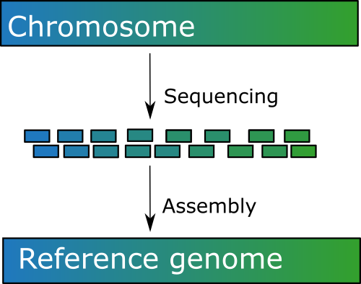
Genome assembly with short reads

Slide 5
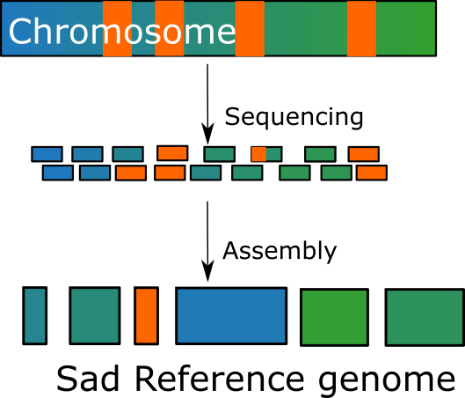
Genome assembly with short reads

Slide 6
Genome assembly with short reads

Slide 7
Genome assembly with short reads

Slide 8


So make the reads longer

Slide 9
Longer reads: two new problems
(Di)ploidy can lead to incorrectly phased haplotypes
Ideally get a haploid tissue or inbred line
Otherwise some assemblers deal with this

Slide 10
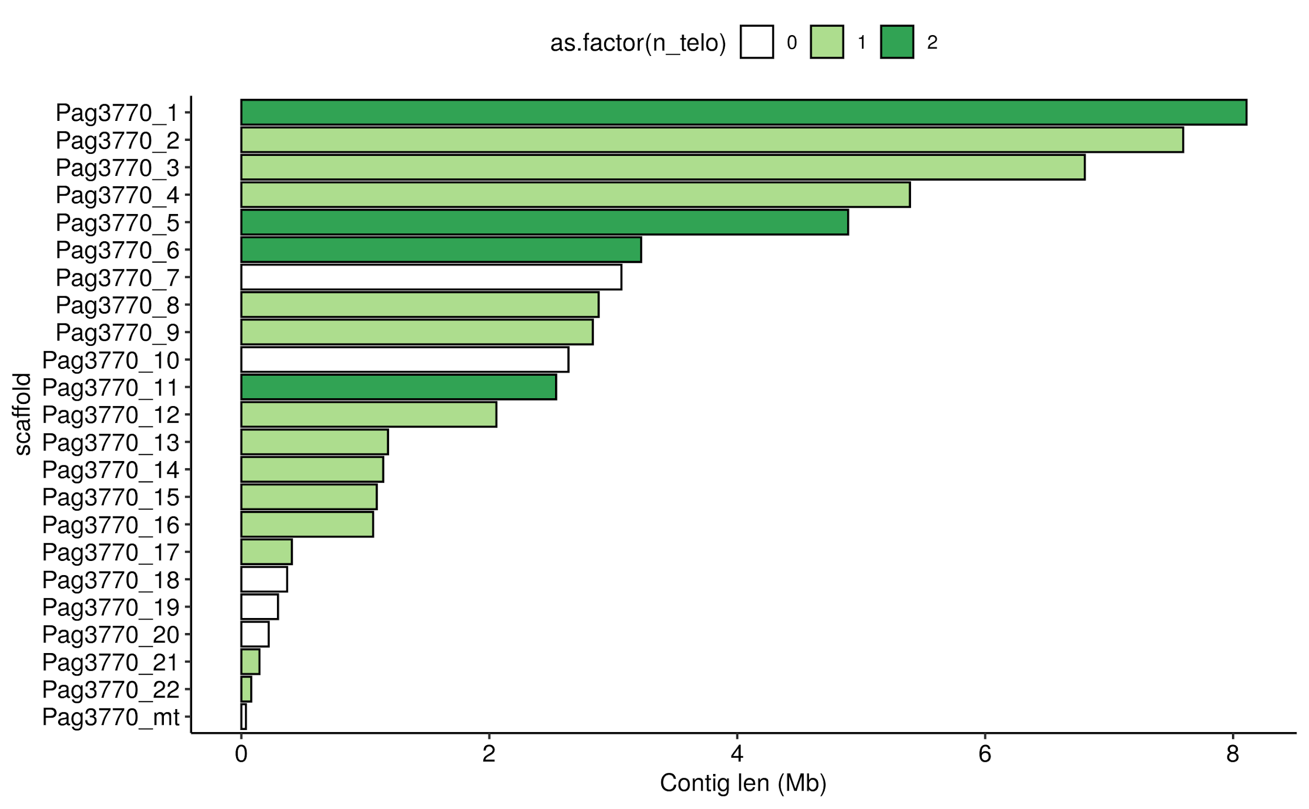

Slide 11
Longer reads: two new problems
(Di)ploidy can lead to incorrectly phased haplotypes
Ideally get a haploid tissue or inbred line
Otherwise some assemblers deal with this
Its soooo close!
Use another technology to scaffold longer contigs

Slide 12
Scaffolding approaches
Recombination mapping
Optical mapping
10x (sequencing in a bubble)
HiC

Slide 13

The genome:
now showing in 3D

Slide 14
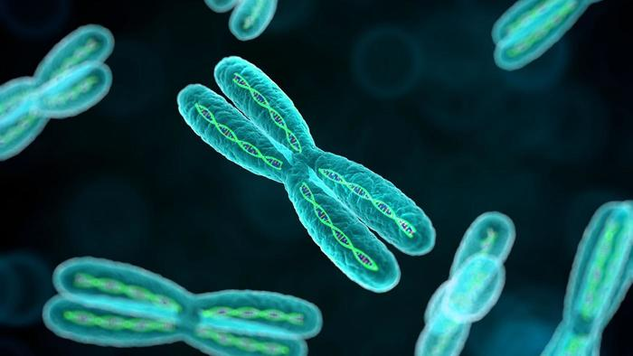
DNA packaged into chromosomes….

Slide 15
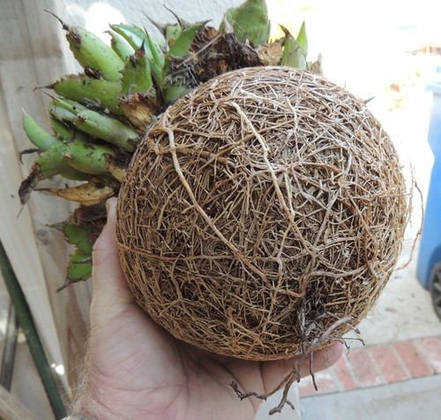

Slide 16
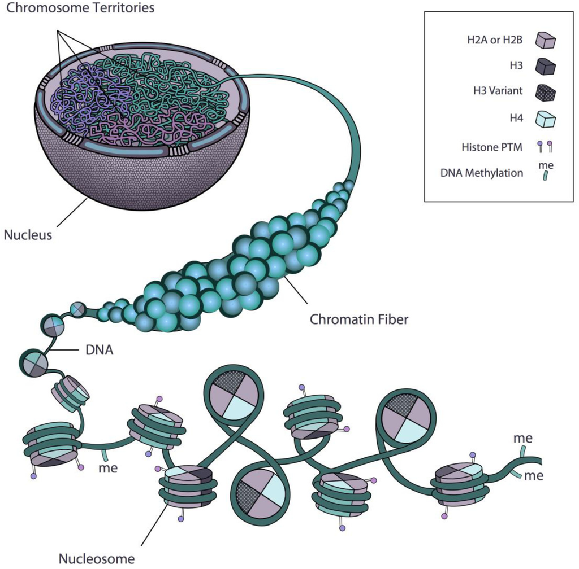

Slide 17
HiC uses short read sequencing to capture 3D structure of the genome

Slide 18
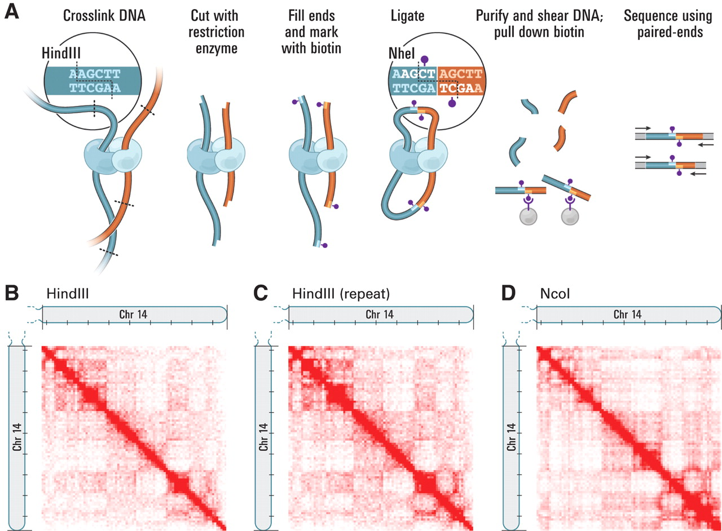
Crosslinking to “freeze” interactions

Slide 19
Cut with and RE, and tag with biotin

Slide 20
Ligate to join interacting regions

Slide 21
Pull down biotin to get only ligation sites

Slide 22
Now sequence!

Slide 23
The Contact Map

Slide 24
HiC in practice

Slide 25
Use a HiC aware aligner

Slide 26
HiC artefacts
Self-ligation
Dangling ends

Slide 27
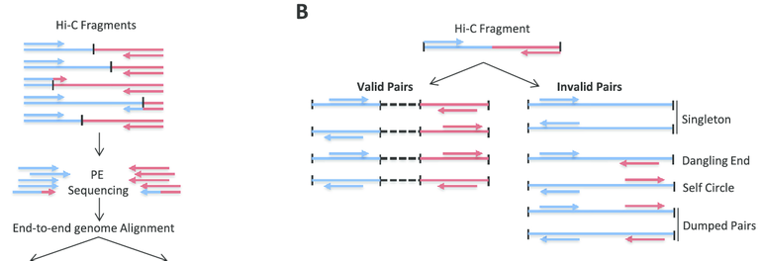
HiC artefacts

Slide 28
Lots of HiC QC tools
HiCUP
Many analysis pipelines include this step
Be sure to match the library prep (some reduce artefacts at prep stage)

Slide 29
Make a contact map
There are not shortage of tools for this ( we are learning juicebox today)
All tools need to deal with a few issues

Slide 30
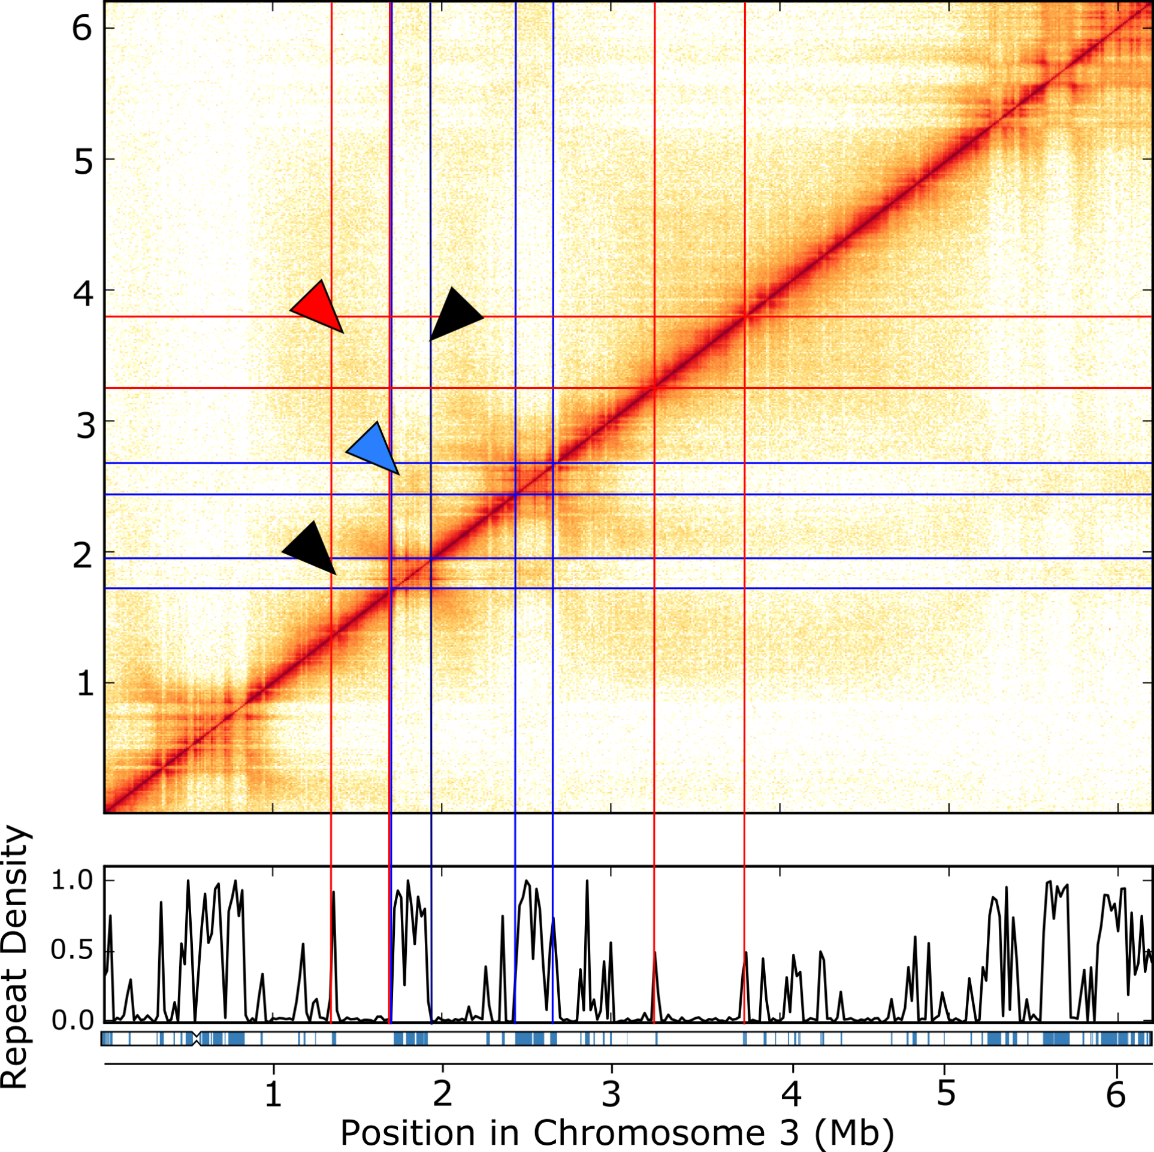
Normalisation

Slide 31
Normalisation
Account for:
Systematic mapping issues
Coverage
Interaction distance

Slide 32
You have nice HiC data, what should you do with it?

Slide 33
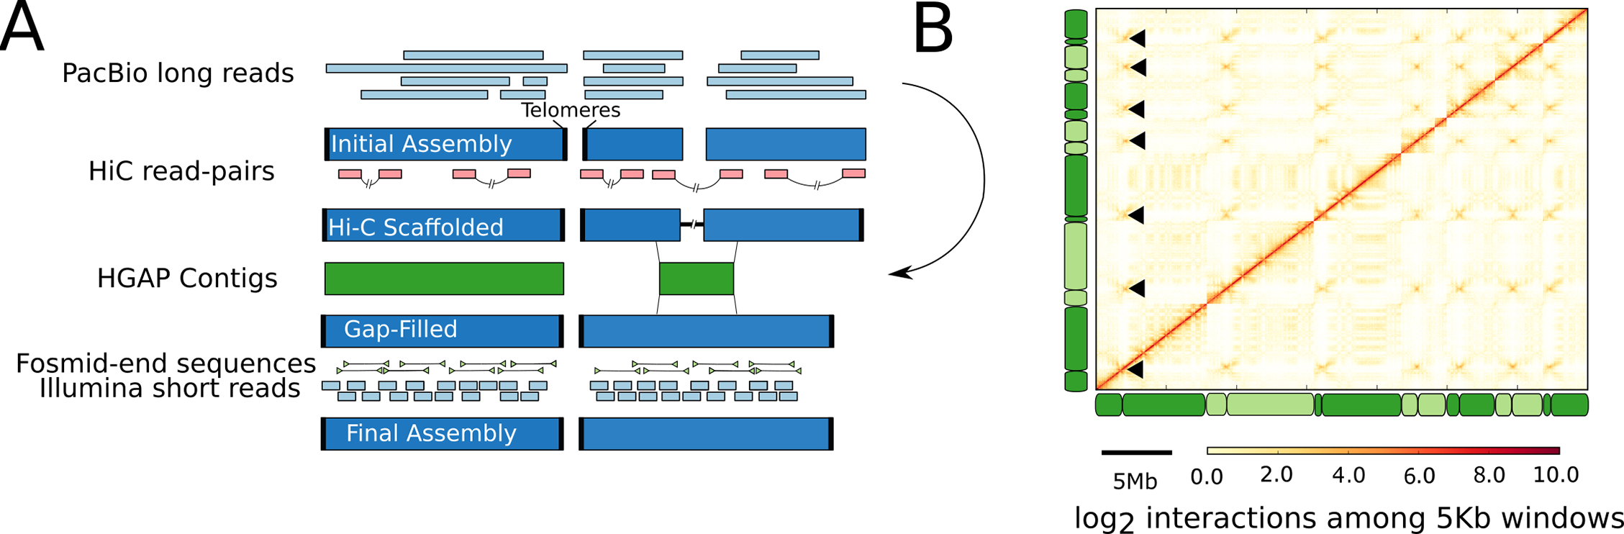
Find the centromeres!

Slide 34
Check assembly errors

Slide 35
Assemble a genome

Slide 36
Assemble a genome
Falcon Phase (Pacbio specific)
3D DNA
Any number of other HiC scaffolders

Slide 37
Analyse chromatin folding

Slide 39
Analyse chromatin folding
What parts of the genome are tightly packed, what parts are open and ready to transcribe?
Are there self-interacting domains (“TADs”) in the genome?
Are genes, histones, motifs etc associated with domains?
Do structures change between species, strains, conditions?

Slide 40
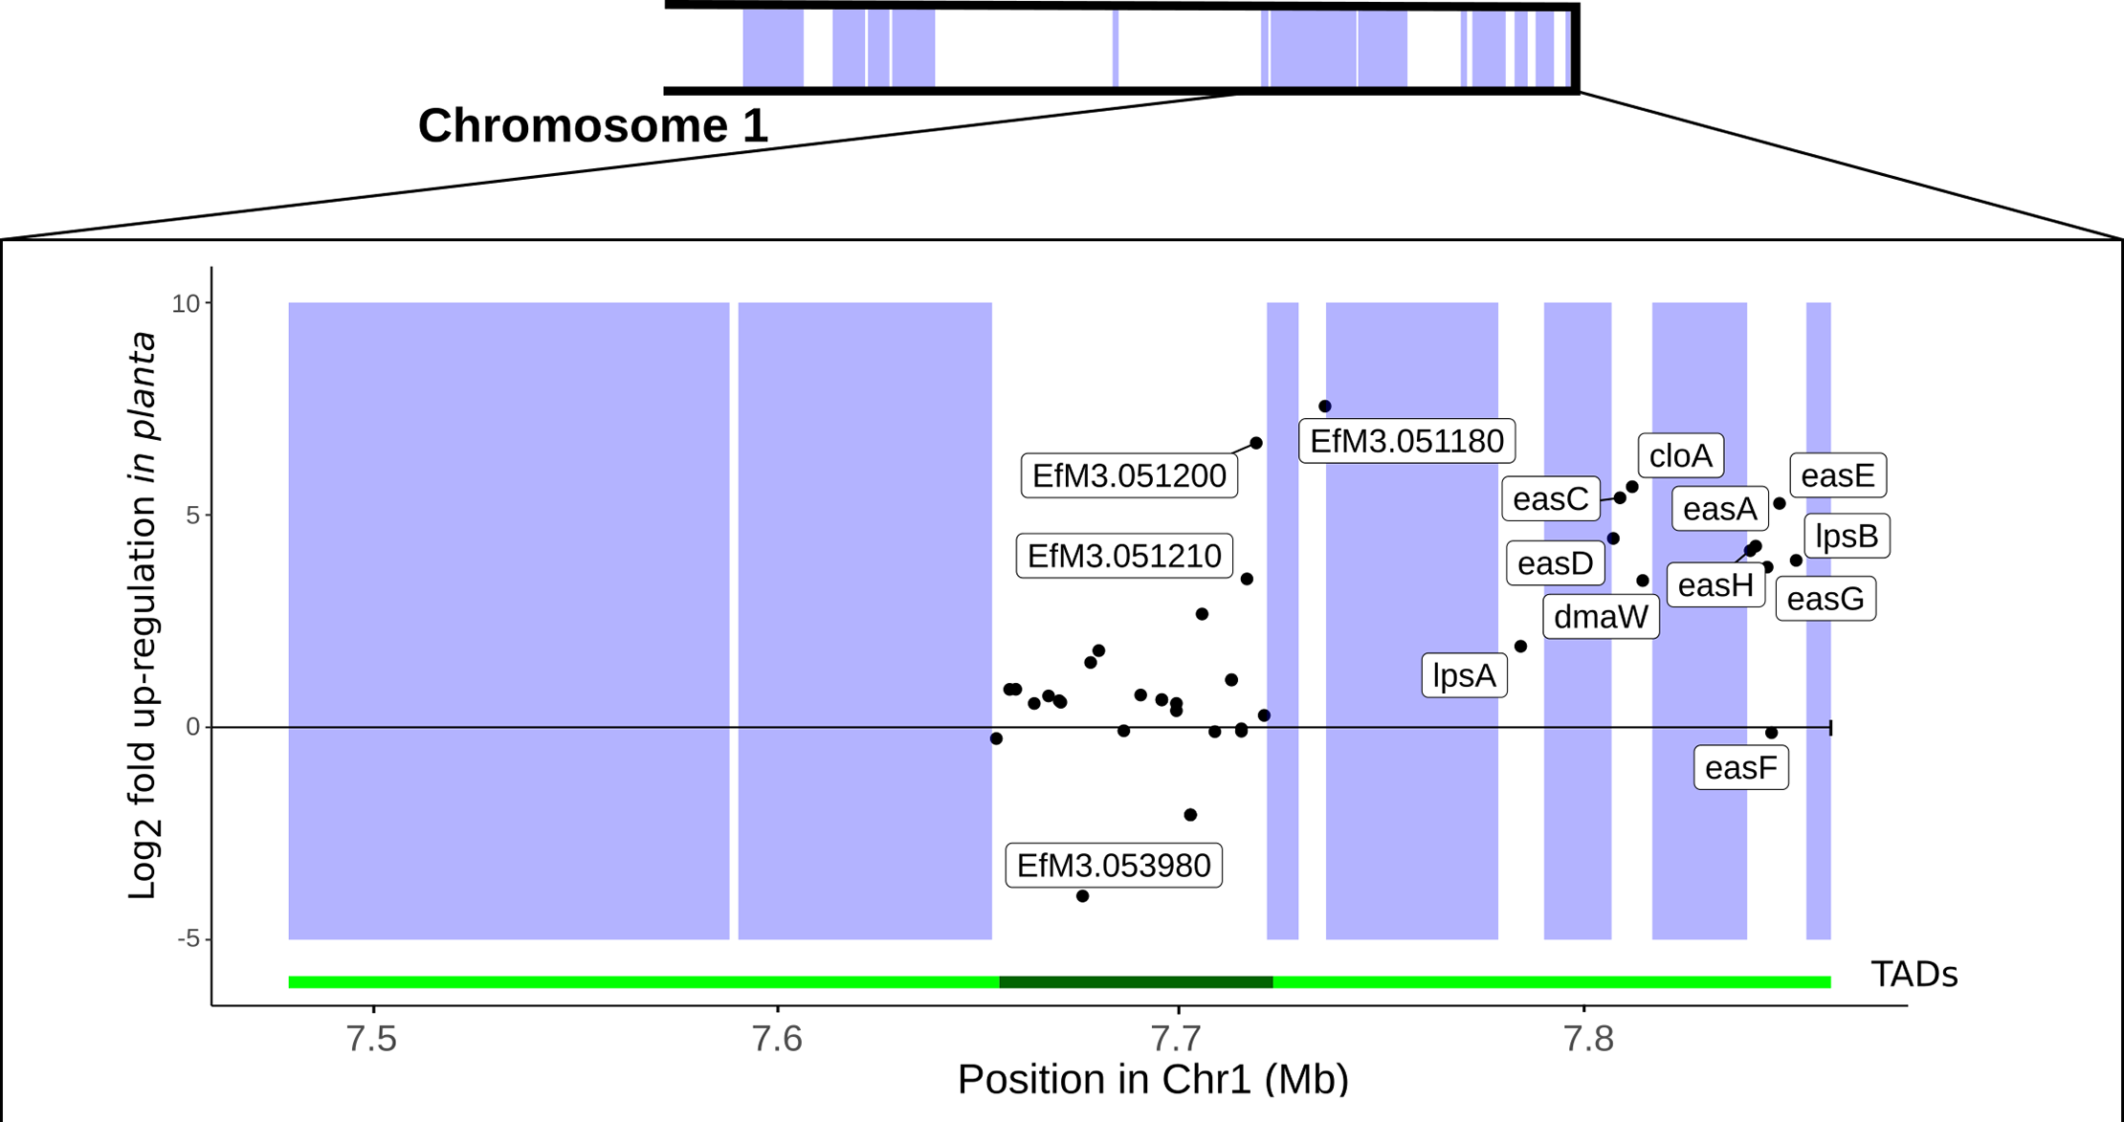

Slide 41
The Big Summary Slide
HiC uses short read sequencing to measure interactions between genomic regions.
Useful for scaffolding, because most interactions are cis and relatively short scale.
BUT also a window in chromatin folding/gene expression, so not just an assembly tool.

